Slide 1


←
__Data Mining
1 page
Chapter 8:
Advertising on the Web
Gabriella Pasya Irianti
(226750)
November, 2025

Slide 2
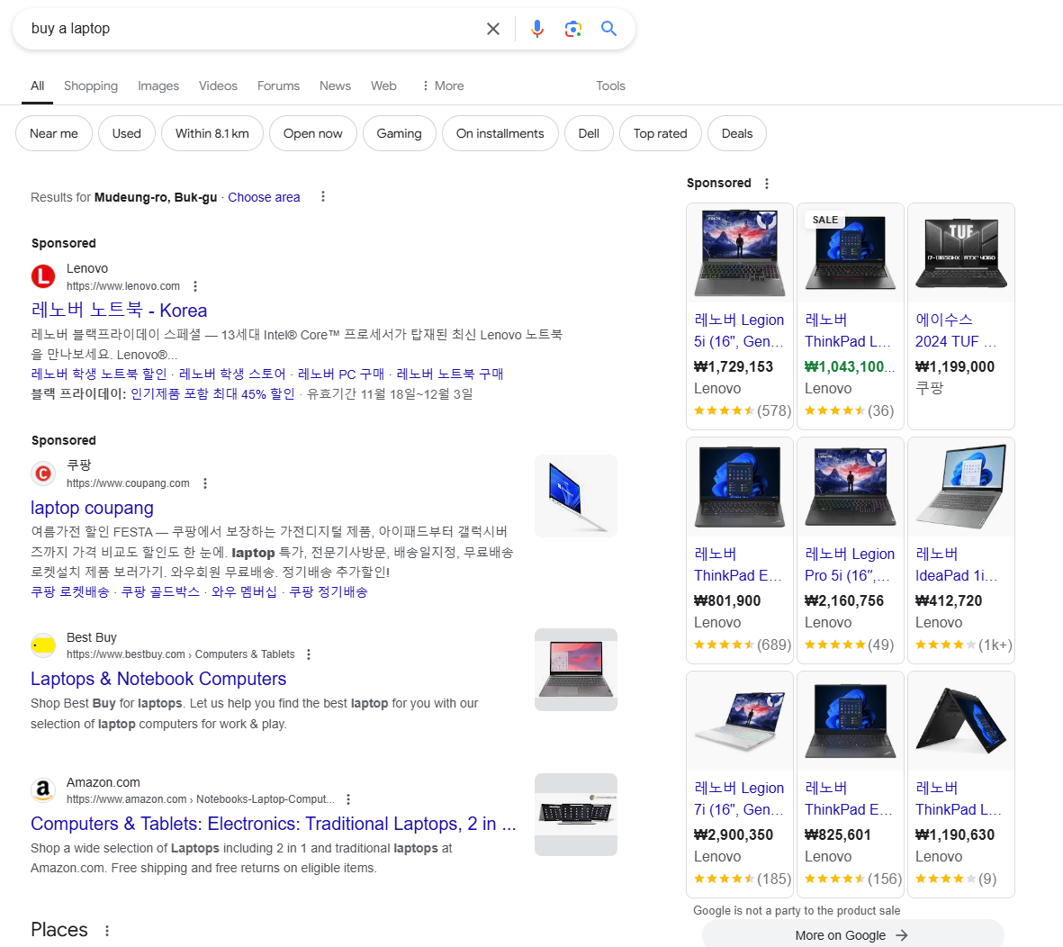
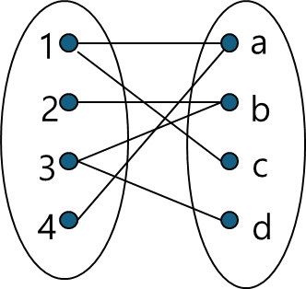
←
Overview
__Data Mining
2 page
Subcription Advertising
Input: Search query (e.g., “laptop").
Process: Keyword matching + bids + click probability.
Output: Ranked ads (ordered by relevance and bid).
Search Advertising = Most Profitable Online Ad Venue.
The "Adwords Model" matches search queries to relevant ads.
Algorithms used are greedy (maximize immediate revenue) and on-line (make real-time decisions without future knowledge).
Outline
8.1 Issues in Online Advertising
8.2 On-Line Algorithms
What types of advertising can be found in the web?
What factors should be considered for different types of advertising?
What is On-line algorithms and Off-line algorithms?
What if Greedy Algorithms and Competitive Ratio?
Examples

Slide 3
←
__Data Mining
3 page
8.1 Issues in Online Advertising

Slide 4
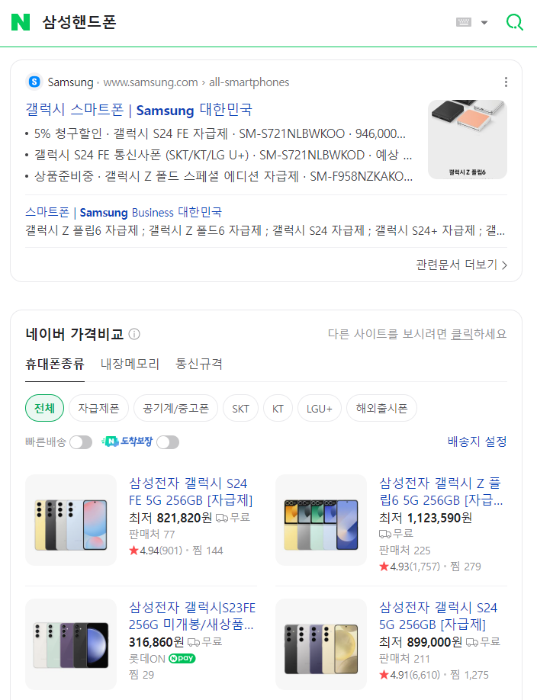
←
8.1.1 Advertising Opportunities
__Data Mining
4 page
Search Ads
Placement: Appear alongside or above search engine results when users enter a query.
Payment Model: Advertisers pay only when the ad is clicked (Pay-Per-Click or PPC model).
Targeting:
Ads are selected based on keywords specified by the advertiser.
Additional factors like the bid amount, click-through rate (CTR), and advertiser's budget influence which ads are shown.
Dynamic Selection:
Ads are chosen and displayed in real-time based on the user's search query.
Purpose: To capture immediate user intent, targeting users actively searching for products or services.
Example: An ad for "convertible cars" shown when a user searches for "buy convertible car."

Slide 5
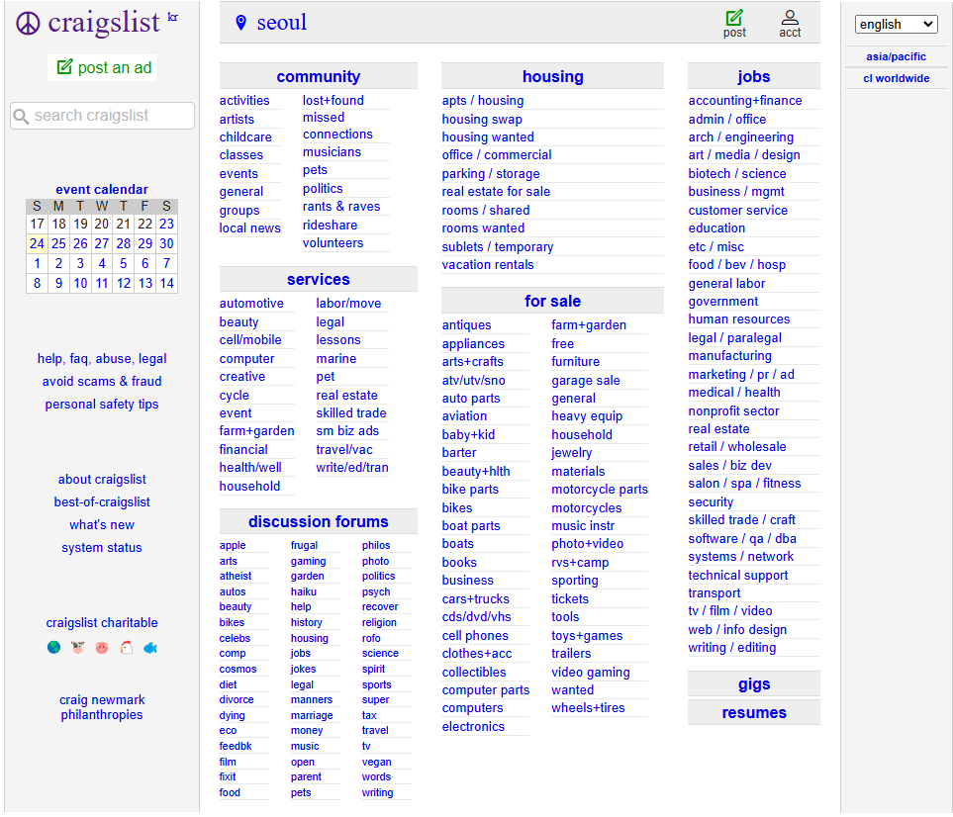
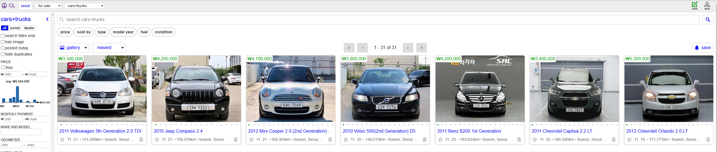
←
8.1.1 Advertising Opportunities
__Data Mining
5 page
Direct Ads
Placement: Static placements on specific platforms like eBay, Craigslist, or auto trading sites.
Payment Model: Advertisers might pay a fee, a commission, or sometimes post ads for free.
Targeting:
Relies on user activity on the platform (e.g., searching for specific items or browsing categories).
No advanced algorithms or bidding processes are typically involved.
Static Selection:
Ads are pre-posted by advertisers and are retrieved when users search or browse categories.
Purpose: To provide general visibility for products or services on platforms where users browse or shop.
Example: A listing for a used "convertible car" on Craigslist or eBay.

Slide 6
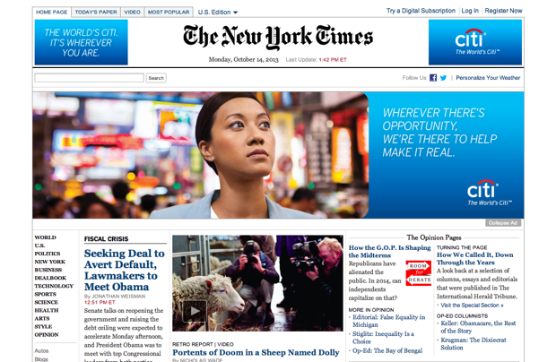
←
8.1.1 Advertising Opportunities
__Data Mining
6 page
Display Ads
These are static or dynamic ads shown on various websites.
Payment Model: Advertisers are charged a fixed rate per impression (one view of the ad when a user loads the page).
A new impression is counted every time the page is reloaded, even by the same user.
Dynamic Display: The ads displayed may rotate or change each time the page is loaded.
Contextual Ads in Online Stores
Platforms like Amazon use their own algorithms to show ads.
Ads are not directly paid for by product manufacturers.
Purpose: The store selects ads to maximize the likelihood that the user will find the product relevant and make a purchase.
These ads are customized based on user behavior or preferences, making them highly targeted.

Slide 7

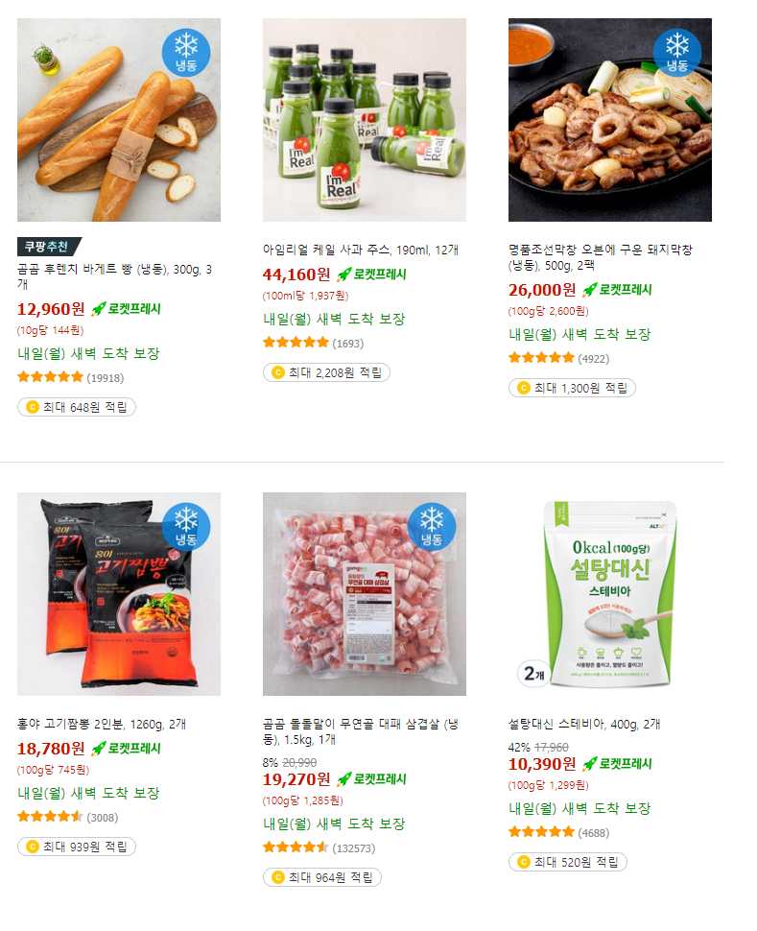
←
8.1.1 Advertising Opportunities
__Data Mining
7 page
Display Ads
These are static or dynamic ads shown on various websites.
Payment Model: Advertisers are charged a fixed rate per impression (one view of the ad when a user loads the page).
A new impression is counted every time the page is reloaded, even by the same user.
Dynamic Display: The ads displayed may rotate or change each time the page is loaded.
Contextual Ads in Online Stores
Platforms like Amazon use their own algorithms to show ads.
Ads are not directly paid for by product manufacturers.
Purpose: The store selects ads to maximize the likelihood that the user will find the product relevant and make a purchase.
These ads are customized based on user behavior or preferences, making them highly targeted.

Slide 8
←
8.1.2 Direct Placement of Advertisements
__Data Mining
8 page
When advertisers can place ads directly, such as a free ad on Craig’s List or the “buy it now” feature at eBay, there are several problems that the site must deal with.
How Ads Are Matched to Queries:
Ads are matched to user queries (e.g., "apartment Palo Alto") using:
Inverted Index: A system that indexes words in ads, similar to a search engine, to find ads containing all the words in a query.
Database Parameters: Advertisers can use specific fields like "manufacturer," "model," or "color" to describe their ads. This structured data makes matching queries more precise (e.g., filtering for specific car models).
Users can also use dropdown menus or similar tools to refine their searches, ensuring better matches.

Slide 9
←
8.1.2 Direct Placement of Advertisements
__Data Mining
9 page
Ranking
Click Probability
Challenges in Ranking:Unlike web search, there are no natural indicators (e.g., backlinks) to determine which ads are more "important."
Ranking Strategies:
Most-Recent-First:
Simple and equitable.
However, it can be abused—advertisers may frequently repost slightly modified versions of their ads to stay at the top.
Solutions to detect similar ads (e.g., text similarity detection) have been discussed in earlier sections.
Attractiveness-Based Ranking:
Ads are ranked based on how often they are clicked (click-through rate or CTR). The assumption is that more attractive ads receive more clicks.
Three main factors affect whether an ad is clicked:
Position in the List:
The first ad in a list is much more likely to be clicked.
The likelihood of clicks drops exponentially as the ad's position moves down.
Relevance to Query Terms:
Ads are more appealing if they explicitly include terms from the user query.
Example: An ad for a "used convertible" is more attractive when the query contains the word "convertible," even if the ad is relevant without it (e.g., matching just "used car").
Opportunity for Evaluation:
New ads need to be displayed enough times to estimate their attractiveness (CTR).
If all ads start with a click probability of 0, they might never get shown, making it impossible to evaluate their effectiveness.

Slide 10

←
8.1.3 Issues for Display Ads
__Data Mining
10 page
Limitations of Display Ads
Display ads on the web share similarities with traditional media (e.g., newspaper or magazine ads).
Effectiveness Issues:
Ads are shown to a broad audience, many of whom may not be interested.
For example, an ad for Chevrolet in the New York Times or on Yahoo! might be irrelevant to many viewers (e.g., those who already own a car or don’t drive).
The cost per impression for web display ads is low (fractions of a cent) because of their general lack of focus.

Slide 11

←
8.1.3 Issues for Display Ads
__Data Mining
11 page
Specialization to Improve Effectiveness
Traditional media addressed this by creating specialized outlets (e.g., Golf Digest for golf enthusiasts).
Ads in such focused media have a higher probability of engaging the right audience and justify charging more per impression.
The same principle applies to the web:
An ad for golf clubs on a golf-related page (e.g., sports.yahoo.com/golf) is far more effective than placing it on a general Yahoo! homepage.

Slide 12

←
8.1.3 Issues for Display Ads
__Data Mining
12 page
Unique Advantages of Web Display Ads
The web surpasses traditional media because it allows personalized ad targeting:
Ads can be tailored based on individual user data, regardless of the specific webpage the user is on.
For instance, if a user like "Sally" is identified as a golf enthusiast, she can be shown golf-related ads on any site, not just on golf-related pages.
Methods for Personalization
Sally’s interest in golf can be deduced in various ways, such as:
Membership in a golf-related group on social media (e.g., Facebook).
Frequent mentions of "golf" in her email conversations (e.g., Gmail).
Time spent browsing golf-related websites (e.g., Yahoo!'s golf page).
Frequent search queries related to golf.
Bookmarking golf course websites.

Slide 13
←
8.1.3 Issues for Display Ads
__Data Mining
13 page
Privacy Concerns
Personalization depends on collecting and analyzing user data, which raises significant privacy issues:
Users often appreciate relevant ads (they're less intrusive and more useful).
However, there's a risk of misuse if sensitive data (e.g., user preferences or behavior) is exposed to people outside the algorithms managing it.
The tradeoff: Effective, free services supported by ads rely on such data collection, but it opens the door to potential exploitation or privacy violations.

Slide 14
←
__Data Mining
14 page
8.1 Online Algorithms

Slide 15
←
8.2.1 On-line and Offline Algorithms
__Data Mining
15 page
Off-Line Algorithms
Definition: These algorithms have access to all data upfront before making any decisions.
Example: If you could see all search queries for a month, you could plan the best way to allocate ads for maximum revenue and impressions.
Strength: Off-line algorithms produce optimal results because they work with complete information.
Limitation: They are impractical for real-time applications like search ads, as users can’t wait for their queries to be processed after a month.
On-Line Algorithms
Definition: These algorithms make decisions in real time, as each piece of data (e.g., a search query) arrives.
Example: When a query like "chesterfield" arrives, the algorithm must immediately decide which ad to show without knowing future queries.
Strength: They are ideal for real-time systems where decisions must be made instantly.
Limitation: They don’t have knowledge of future data, so they can’t always make the globally optimal decision.

Slide 16
←
8.2.1 On-line and Offline Algorithms
__Data Mining
16 page
Why On-Line Algorithms Are Needed:
Each search query requires an immediate response.
Information from past data (e.g., click-through rates, remaining budget) can be used, but future queries remain unknown.
Challenges:
Balancing advertiser budgets: Ads with higher bids often seem preferable (e.g., B bidding 20 cents for "chesterfield"), but showing them too often might leave other advertisers’ budgets unspent.
Real-time trade-offs: Without knowing future queries (e.g., "sofa"), decisions may lead to suboptimal revenue or impressions.
A | B
chesterfield | sofa, chesterfield
$10c | $20c
$100/month | $100/month
Decision Dilemma:
If you show B's ad for "chesterfield" now (because they bid more), B's budget may run out quickly, especially if there are many "sofa" queries later.
If you show A's ad for "chesterfield," A’s budget gets utilized, and B still has enough to cover "sofa" queries later.
Insight:
If you knew there would be 500+ sofa queries, it’s better to show A’s ad now and save B’s budget for "sofa."
Since future queries are unknown, an on-line algorithm has to make a greedy decision based on available information.

Slide 17
←
8.2.2 Greedy Algorithms
__Data Mining
17 page
Definition: Greedy algorithms make decisions incrementally, based on the current input and past information, to maximize immediate gains.
Key Feature: They do not consider future inputs, focusing only on what seems optimal at the moment.
A | B
chesterfield | sofa, chesterfield
$10c | $20c
$100/month | $100/month
How the Greedy Algorithm Works
The first 500 queries (either "chesterfield" or "sofa") are assigned to B because B bids more (20 cents) than A (10 cents).
B’s budget is now depleted: $100 ÷ $0.20 = 500 queries.
Total revenue so far: $100.
After B’s budget is exhausted:
The next 1000 "chesterfield" queries are assigned to A.
"Sofa" queries receive no ad because A doesn’t bid on "sofa."
Total revenue remains $100, as no additional revenue comes from "sofa" queries.
Comparison to Off-Line Algorithm
If an off-line algorithm (with future knowledge) were used:
Assign the first 500 "chesterfield" queries to A (since B will have "sofa" queries later):
Revenue from A: 500 × $0.10 = $50.
Assign the next 500 "sofa" queries to B:
Revenue from B: 500 × $0.20 = $100.
Total Revenue: $50 (A) + $100 (B) = $150.

Slide 18
←
8.2.3 The Competitive Ratio
__Data Mining
18 page
Definition: The competitive ratio is the worst-case ratio between the result of an on-line algorithm and the optimal off-line algorithm for the same problem.
It’s a constant c, where 0<c≤1.
If c=1, the on-line algorithm performs as well as the off-line algorithm (rare for most real-world problems).
Purpose: It quantifies the efficiency or performance loss of the on-line algorithm due to its inability to see future inputs.
A | B
chesterfield | sofa, chesterfield
$10c | $20c
$100/month | $100/month
Competitive Ratio of the Greedy Algorithm
Scenario Recap (from Example 8.2):
Performance Comparison:
Greedy Algorithm:
Earned $100 in total revenue.
Optimal Off-Line Algorithm:
Earned $150 by allocating queries more strategically.
Worst-Case Competitive Ratio
By modifying the inputs, we can identify a lower competitive ratio:
Suppose A’s bid is raised to just below B’s bid (e.g., 19.9 cents instead of 10 cents).
Greedy Algorithm:
Still assigns all initial queries to B (since B has the highest bid).
Earns $100.
Optimal Off-Line Algorithm:
Assigns half the queries to A and half to B, earning nearly $200 as ϵ approches 0

Slide 19
←
__Data Mining
19 page
Thank you

